Slide 1
World Layoffs Analysis Using MySQL
Exploratory Data Analysis
Rishikesh Mohite | Aspiring Data Analyst

Slide 2
INTRODUCTION
World layoff Exploratory data analysis using MySQL :
Analyzed a real-world dataset of global layoffs using MySQL for exploratory data analysis.
Focused on key dimensions like country, industry, company stage, and layoff percentage.
Cleaned and transformed the data using SQL queries for accurate insights.
Used SQL aggregations, grouping, sorting, and date functions to answer analytical questions.
Results can help in understanding economic shifts and workforce dynamics globally.
The data contains the layoffs from 2020 (COVID) to 2025 (till date).

Slide 3
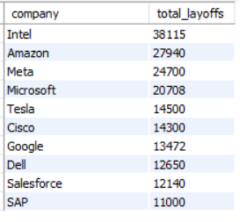
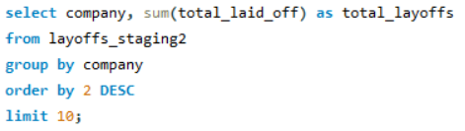
1. Top 10 companies having the highest total layoffs ?

Slide 4
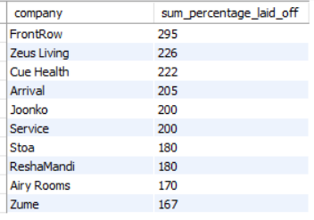
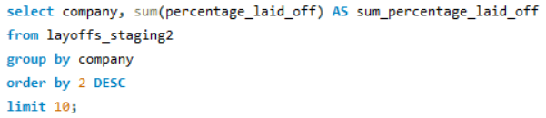
2. Top 10 companies that had the highest layoff percentages overall?

Slide 5
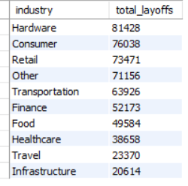
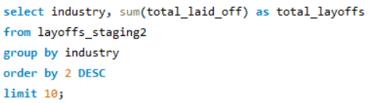
3. Top 10 industries affected with layoffs ?

Slide 6
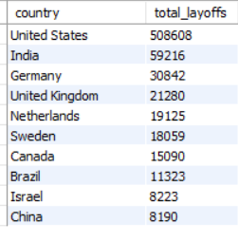
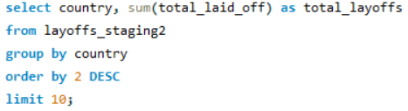
4. Which countries saw the highest no. of layoffs ?

Slide 7
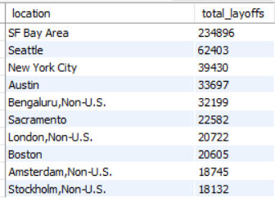
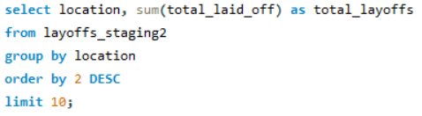
5. Which cities/locations had the highest no. of layoffs ?

Slide 8
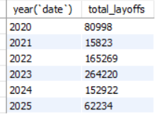
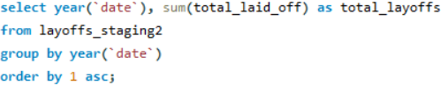
6. How have layoffs changed year by year ?

Slide 9
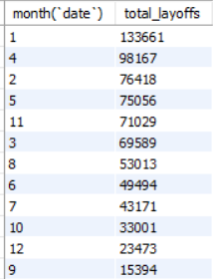
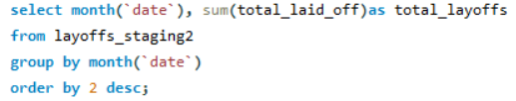
7. Which month has the highest layoffs overall ?

Slide 10
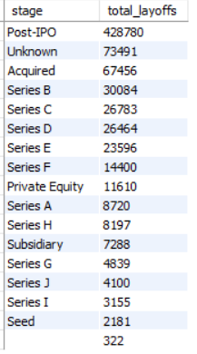
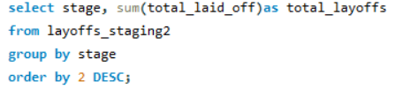
8. Which stages of company are most associated with layoffs ?

Slide 11

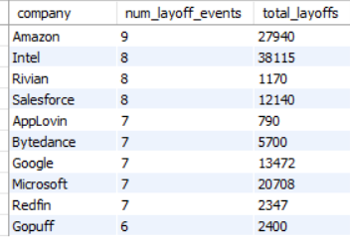
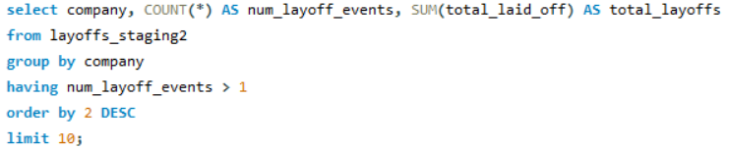
9. Which companies had multiple rounds of layoffs?

Slide 12
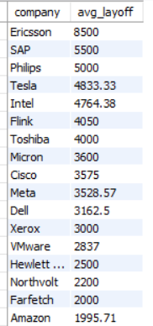
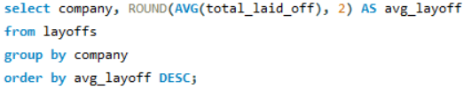
10. Average layoffs per company

Slide 13
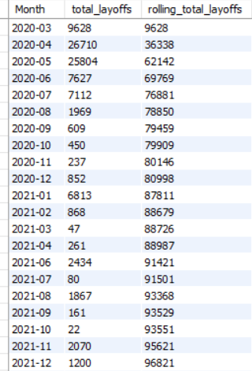
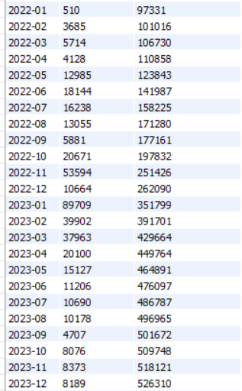
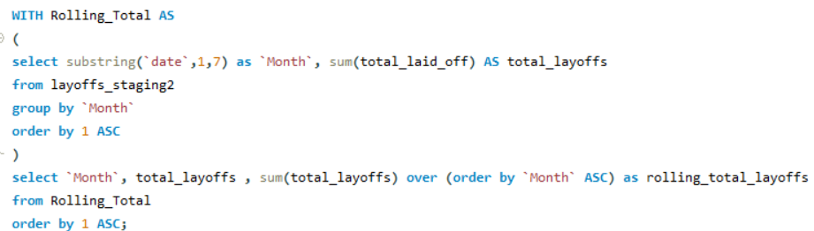
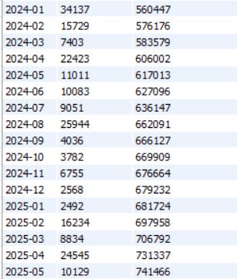
11. What is the monthly trend of layoffs with a cumulative total ?

Slide 14
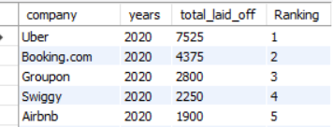
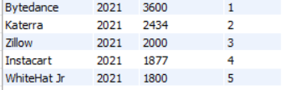
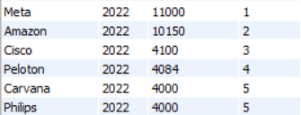
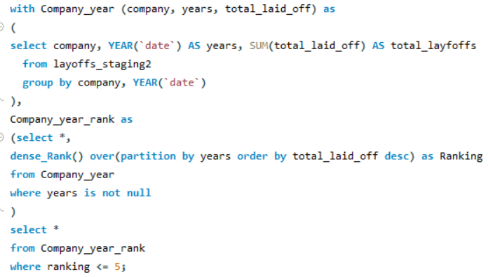
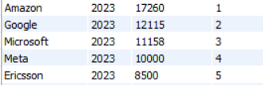
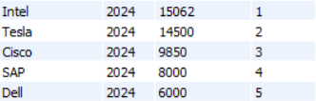
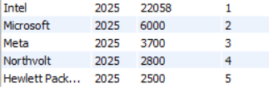
12. Who were the top 5 companies by layoffs in each year ?

Slide 15
KEY INSIGHTS FROM THIS PROJECT
Layoffs peaked in 2022, showing a major surge post-COVID.
The U.S., India, and Canada had the highest number of layoffs globally.
Hardware, Consumer and Retail industries were among the hardest hit sectors.
Companies like Intel, Meta, Amazon, and Google led in total layoffs.
Several companies had multiple layoff events, indicating ongoing workforce instability.
Monthly and yearly trends helped understand the evolution of global layoffs over time.

Slide 16
SUMMARY & LEARNINGS
This project explored global layoff trends using a structured SQL-based EDA approach in MySQL.
Cleaned and transformed real-world layoff data using SQL queries.
Performed aggregation and time-based analysis to uncover key patterns across companies, industries, countries, and funding stages.
Used window functions and CTEs for advanced analytics like rolling totals and top company rankings by year.
Demonstrated how SQL alone can extract deep insights from business data — no Python or visualization tools were used.

Slide 17
THANK YOU !

